Slide 1
Parallel Lines, Transversals, Base Angles & Exterior Angles

Slide 2
Parallel Lines & Transversals

Slide 3
Alternate Interior Angles
Opposite sides of the transversal & inside the parallels
Are congruent
Equation:
angle = angle

Slide 4
Consecutive Interior Angles
Same side of the transversal & inside the parallels
Are supplementary
Equation:
angle + angle = 180°

Slide 5
Alternate Exterior Angles
Opposite sides of the transversal & outside the parallels
Are congruent
Equation:
angle = angle

Slide 6
Corresponding Angles
Same location but at different intersections (only travel on the transversal)
Are congruent
Equation:
angle = angle

Slide 7
Isosceles Triangles

Slide 8
Base Angles
If 2 angles in a triangle are congruent, then the sides opposite them are congruent.

Slide 9
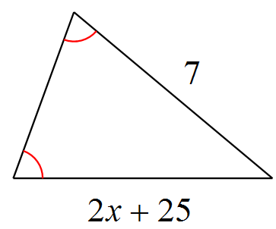
Solve for x.
2x + 25 = 7
2x = -18
12
x = -9

Slide 10
Base Angles
If 2 sides in a triangle are congruent, then the angles opposite them are congruent.

Slide 11
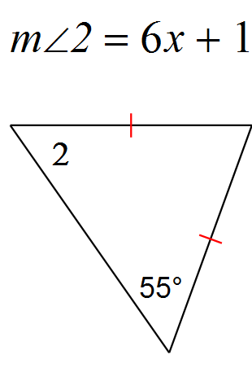
Solve for x.
6x + 1 = 55
6x = 54
3
x = 9

Slide 12
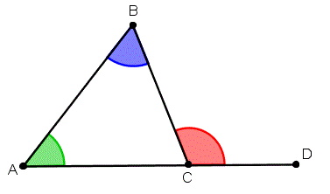
Exterior Angle Theorem
The measure of an exterior angle of a triangle is equal to the sum of the measures of the two non-adjacent interior angles of the triangle.

Slide 13
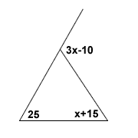
Solve for x.
3x - 10 = x + 15 + 25
2x = 50
x = 25

